Slide 1
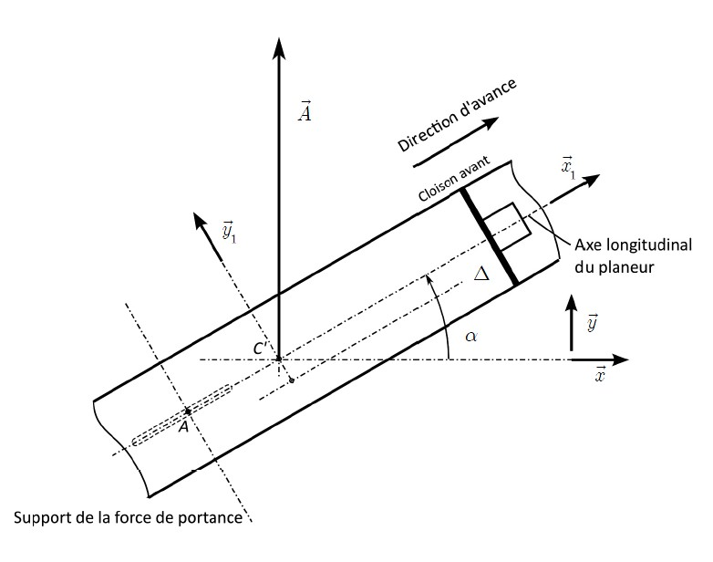
F_{T} (direction x₁)
=10.sin(α)
F_{H}=A-P
=F_{P}+F_{T}=10N
F_{P} (direction y₁)
=10.cos(α)

Slide 2
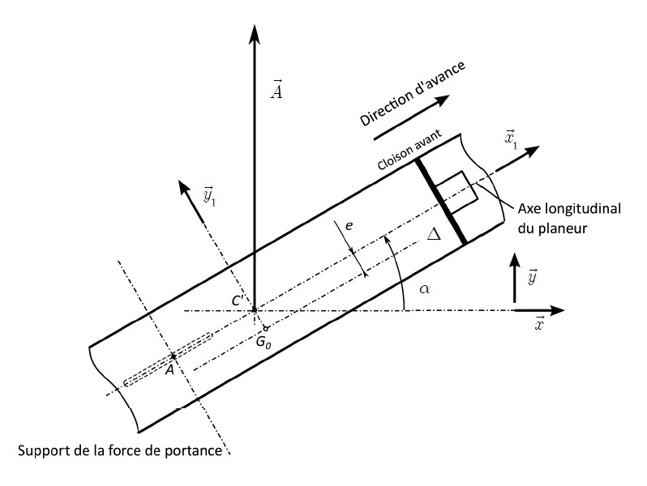
a
b
Théorème du moment statique:
b=a.A/P

Slide 3
a
b
G
δ
a=AC’.cos(α)
b=e.sin(α)+δ.cos(α)
b=a.A/P
e.sin(α)+δ.cos(α)=AC’.cos(α).A/P
δ=AC’.A/P- e.tan(α)
δ(30)=AC’.A/P- e.tan(30)

